Slide 1
2023 Start Summit Hack: Case deep-dive
2

Slide 2

At DKSH Healthcare, we make medication readily available across a comprehensive mix of medical channels
Our mission: Healthcare for all
Notes:
Business Unit Healthcare is a leading distributor and commercial outsourcing partner of choice for pharmaceutical, OTC, consumer health, and medical device companies in Asia Pacific
Products are delivered to multiple channels in Asia Pacific including modern and traditional trade, drugstores, pharmacies, clinics, hospitals, and eCommerce platforms
With nearly 8,000 healthcare experts operating across 16 markets, DKSH Healthcare stands for deep market knowledge
Business Unit Healthcare serves 575 clients such as Pfizer, Roche, Alcon, Sanofi, and Bayer
Business Unit Healthcare is a leading distributor and commercial outsourcing partner of choice for pharmaceutical, OTC, consumer health, and medical device companies in Asia Pacific
Products are delivered to multiple channels in Asia Pacific including modern and traditional trade, drugstores, pharmacies, clinics, hospitals, and eCommerce platforms
With nearly 8,000 healthcare experts operating across 16 markets, DKSH Healthcare stands for deep market knowledge
Business Unit Healthcare serves 575 clients such as Pfizer, Roche, Alcon, Sanofi, and Bayer

Slide 3
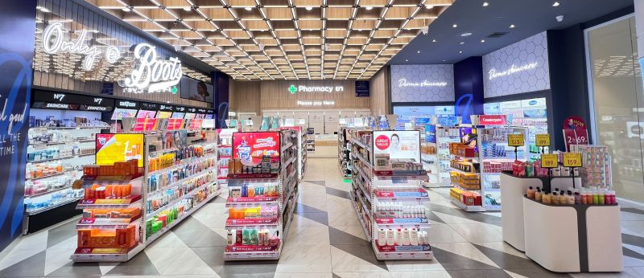
Channel spotlight: chain pharmacies

Slide 4






Today, chain pharmacies in Asia offer a diverse but fragmented portfolio of services
Core business
Point of Sales for medical products
Adjacent services
Additional patient solutions and services
Sales
In-store and online sales of medical products (Consumer Health, OTC, Prescription Medicine, Medical Devices)
Collection
Direct purchase at pharmacy, Click and Collect, home medication delivery
Medical services
Home healthcare services, in-pharmacy blood collection and diagnostics services, telemedicine
What other features / services could be relevant and meaningful for patients?

Slide 5

The business case: build a one-stop digital pharmacy solution delivering a seamless patient care experience
Expected product:
Digital pharmacy solution / application prototype

Slide 6
Evaluation criteria
UX/UI and digital solution patient journey: How easy and seamless is it for patients to use the solution to interact with pharmacies?
New features / use cases: additional, relevant features to enhance the patient experience

Slide 7
Thank you for your attention

